Slide 1
Topic 2 – Operators and Variables
VIT 1102 - Introduction to Object Oriented Programming
By Oshadi Alahakoon

Slide 2
VIT1102 - Introduction to Object Oriented Programming
Today’s lecture…
Mathematical operators and expressions
Understanding variables
Using different types of variables
Adding comments and Variable naming in Python
Output formatting in Python

Slide 3
VIT1102 - Introduction to Object Oriented Programming
Mathematical Operators in Python
Following is a list of mathematical operators in Python.
Operator | Operation | Description
+ | Addition | sum = a + b Adds the left value to the right and assigns to sum
- | Subtraction | diff = a – b Subtracts the right value from the left and assigns to diff
/ | Division | dev = a/b Divides left value by right and assigns to dev. Right-side value can not be zero
* | Multiplication | mult = a * b Multiplies left value by right and assigns to mult.

Slide 4
Expressions
VIT1102 - Introduction to Object Oriented Programming
What is an expression?
An expression is made of operands (values) and operators.
Look at the following Expression.
A = 2 * 5 + 8
In this expression there are three Values and two Operators.

Slide 5
Evaluating Expressions
VIT1102 - Introduction to Object Oriented Programming
A = 2 * 5 + 8
The right hand side of the expression get evaluated and get assigned to the left hand side variable.
2 * 5 + 8 = 18
A = 18
Assignment operator

Slide 6
Precedence of Operators
VIT1102 - Introduction to Object Oriented Programming
Expressions evaluate from Left to Right.
Look at the following expression.
A = 2 * 5 + 8 – 12/2
What is the value of A?
Is it 3? Or is it 12?
10 + 8 – 12/2
18 - 12/2
6/2
3
10 + 8 – 6
18 – 6
12

Slide 7
Precedence of Operators cont.…
VIT1102 - Introduction to Object Oriented Programming
When several operators are present in an expression, Python language has well-defined rules for specifying the order in which the operators are evaluated.
It is called Order of Precedence.
The following table shows the order of precedence for some commonly used operators.
You can use parentheses to override the order of precedence.
1 | ^ | exponentiation (to the power)
2 | *, / | multiplication and division
3 | +, - | addition and subtraction

Slide 8
Precedence of Operators
VIT1102 - Introduction to Object Oriented Programming
A = 2 * 5 + 8 – 12/2
Step 1 (* and /) A = 10 + 8 - 6
Step 2 (+ and -) A = 12
Therefore the value of A in above expression is 12. NOT 3.
Parenthesis can change the order of precedence.
A = (2 * 5 + 8 – 12)/2
A = (10+8-12)/2
A = (6)/2
A = 3

Slide 9
Class exercise 1
VIT1102 - Introduction to Object Oriented Programming
Find out the values of A and B manually.
A = 2 * 5 + (8 – 4/2)
B = 2 * (5 + 8) – 4/2
Find out the values of following expressions first manually then using Python console and record your answers.
2**3 + 6 * 9
43 + 28 / 7
90 + 30 + 40 + 22
3 ** 2 + 1
50 + 20 * 8 +(3 +6)
A =16
B = 24

Slide 10
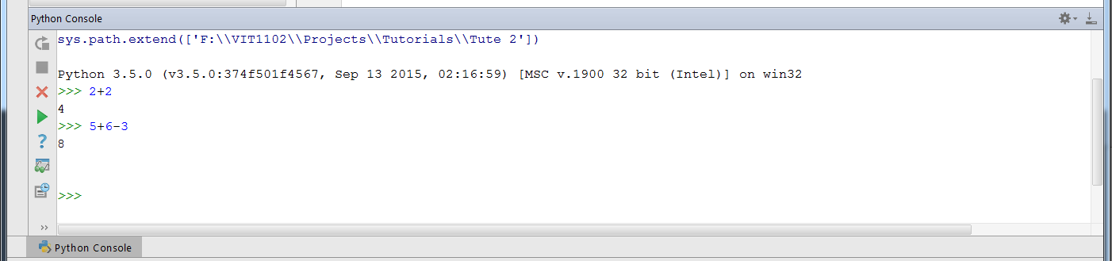
Class exercise using Python console
VIT1102 - Introduction to Object Oriented Programming
Start Python Console by clicking on the icon.
Try some mathematical expressions as shown
Find the values of A and B using Python console.
Click here to start Python Console

Slide 11
VIT1102 - Introduction to Object Oriented Programming
Today’s lecture…
Mathematical operators and expressions
Understanding variables
Use different types of variables
Adding comments and Variable naming in Python
Output formatting in Python

Slide 12
Understanding Variables
VIT1102 - Introduction to Object Oriented Programming
What is a variable?
Definition of a variable is as follows:
A variable is a memory location in computer memory. It has a type and a name. This memory location can store different values of the same type.

Slide 13
VIT1102 - Introduction to Object Oriented Programming
Variables cont.…
We have used variables in Tute 1. Whenever we used input() function, we stored the value user entered in a variable.
In the command:
myName = input(“Please enter your name?)
Whatever the name user entered get stored in the variable myName.
Think of variables like a box that can hold a value.
“”
This is initially empty
myName – is the name of the box

Slide 14
VIT1102 - Introduction to Object Oriented Programming
Variables cont.…
After the command:
myName = input(“Please enter your name?)
Whatever the name user entered get stored in the variable myName.
Say you entered “John”.
Now the box has value “John”
“John”
myName – is the name of the box

Slide 15
VIT1102 - Introduction to Object Oriented Programming
Variables cont.…
You can change the value you store in the variable myName.
If you run the following command:
myName = “Alex”
Then the previous value stored in the variable myName get over written by the new value. It changes to “Alex”.
“Alex”
Now the box has the value “Alex”
myName

Slide 16
Class exercise 2
VIT1102 - Introduction to Object Oriented Programming
myName = input(“Please enter your name”)
Print(myName)
Run this code and enter the name “Jane” as your input. Print() command will eco “Jane” as the output.
Change your code as follows.
What do you expect to see as the output?
myName = input(“Please enter your name”)
myName = “Rose”
myName = “Lee”
Print(myName)

Slide 17
Class exercise 2 cont.
VIT1102 - Introduction to Object Oriented Programming
Examine following code execution by tracing it.
You will see how each line of code change the value in variable myName.
Use online tool available at :
http://www.pythontutor.com/visualize.html#mode=edit
myName = ‘Rose’
myName = ‘ Jack’
myName = ‘Ben’

Slide 18
VIT1102 - Introduction to Object Oriented Programming
Today’s lecture…
Mathematical operators and expressions
Understanding variables
Using different types of variables
Adding comments and Variable naming in Python
Output formatting in Python

Slide 19
VIT1102 - Introduction to Object Oriented Programming
Types of variables in Python
From the previous slides we saw that variables have a name.
They also have a type – A DATA TYPE.
Some of the commonly used data types in Python are as follows
What is the type of variable myName?
Variable myName stored text (String literals) and the type of the variable is String.
Data Type | Python representation | Example literals
String | str | “hi” ‘John’ “ “ ‘I am good!’
Integers | int | 0 -1 4 900
Real Numbers | float | 0 -2 -2.005 900.5

Slide 20
VIT1102 - Introduction to Object Oriented Programming
String variables and string literals
In Python, a string variable can store any string literal (myName is a string variable, it stored literals such as “Rose”, ‘John’ or ‘Lee’).
A string literal assigned to a string variable can be of any length.
String literals start and end with a single or double quote (‘ OR “).
Quotations are not part of the string literal.

Slide 21
VIT1102 - Introduction to Object Oriented Programming
String variables and string literals cont.…
Examples of String literals
All above are Strings. The only requirement for a literal to become a String is to write them inside quotes.
“Hello!”
‘Once upon a time there lived a beautiful little fairy ……..’
“ 10 cats, 2 dogs and an elephant”
‘1 + 2 = 3’
‘My name is John.’
‘###5%%%&***(00000)*(34488’
“0.5 * 2.5”

Slide 22
VIT1102 - Introduction to Object Oriented Programming
Integer variables
Integers are negative or positive whole numbers. Values that can be stored in integer data type range from 2,147,483,648 (–2³¹) to 2,147,483,647 (2³¹– 1)
Reading integers
Run this program and provide a decimal input. What happens?
num1 = int (input ('Please enter an integer number to print '))
print(num1)

Slide 23
VIT1102 - Introduction to Object Oriented Programming
Float Variables
Float numbers are decimal numbers such as money values with dollars and cents. Floats data type range from approximately –10³⁰⁸ to 10³⁰⁸
Reading Floats
Run this program and provide an integer input. What happens?
num1 = float (input ('Please enter a number to print '))
print(num1)

Slide 24
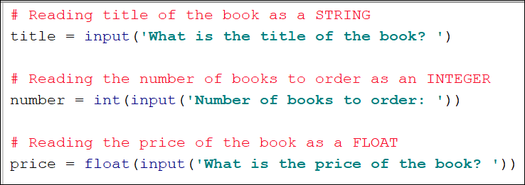
VIT1102 - Introduction to Object Oriented Programming
Example 1

Slide 25
VIT1102 - Introduction to Object Oriented Programming
Today’s lecture…
Mathematical operators and expressions
Understanding variables
Using different types of variables
Adding comments and Variable naming in Python
Output formatting in Python

Slide 26
VIT1102 - Introduction to Object Oriented Programming
Adding comments in your programs
In python code, any text following a # sign (called the pound sign) is a comment.
Comments are not for Python compiler. Compiler ignores them
Each line of comments must start with a # sign
Comments are the programmer’s notes about what the code does. You can write anything in a comment. To help others to read and understand the source code
# This is a comment
# This program add two numbers and print the sum. User need to
# input two numbers for addition

Slide 27
VIT1102 - Introduction to Object Oriented Programming
Adding DocStrings in your programs
DocStrings are similar to comments. But they can contain more than one line of description.
“””
Author: Oshadi
Written in: January
This program add two numbers and print the sum. User need to
input two numbers for addition
“””

Slide 28
VIT1102 - Introduction to Object Oriented Programming
Importance of Adding Comments and DocStrings
Adding comments and DocStrings in your programs is a good programming practice.
Comments are important for future references and modifications to the code. You can also use comments to explain tricky parts of code in a program.
DocStrings can be maintained at the start of the program to record information such as the programmer and version. Also a DocString can describe the purpose of a program.

Slide 29
VIT1102 - Introduction to Object Oriented Programming
Appendix
This section is not for completing in the classroom.
Your instructor will give you a brief explanation about output formatting.
You have already used some formatting in your work using Python f’string.
You may use the examples given to see how formatting works in your own time.
There is too much information to memorise, therefore use these slides as reference on output formatting as you need them.

Slide 30
VIT1102 - Introduction to Object Oriented Programming
Naming Conventions
In computer programming, a naming convention is a set of rules for choosing a name for your variables, types, functions, and other entities in source code and documentation
Please refer to (Sweigart, 2015) pages 22 -23 of the book to understand naming variables according to convention.

Slide 31
VIT1102 - Introduction to Object Oriented Programming
Today’s lecture…
Mathematical operators and expressions
Understanding variables
Using different types of variables
Adding comments and Variable naming in Python
Output formatting in Python

Slide 32
VIT1102 - Introduction to Object Oriented Programming
Output formatting
Formatting text for output is important in data processing applications. Sometimes you may need your output in tabular format.
String and integer data types can be formatted by justifying and setting the field width
Floating point numbers can be formatted by justifying, setting the field width and precision.

Slide 33
VIT1102 - Introduction to Object Oriented Programming
Output formatting cont..
The curly braces { } is the placeholder
Use index positions to designate the variable (argument)
{0} {1} {2} ….
Use format expressions to format number values:
Decimals
{0:.2f} => format decimal value to 2 decimal points
Integers
{0:.0f} => format decimal value to 0 decimal points (in other words integer)

Slide 34
VIT1102 - Introduction to Object Oriented Programming
Output formatting cont..
Use padding value to specify size of field and symbols <.^,> to left align, center and right align
{0:<20} A field of 20 characters wide and align the value to the left of the padded field
{0:^20} A field of 20 characters wide and align the value to the center of the padded field
{0:>20} A field of 20 characters wide and align the value to the right of the padded field

Slide 35
Output formatting - print() function
Example 2
Pass more than one parameter to print().
Combine a literal with variables
Use format function with placeholders
Use format function f with placeholders
Do not use old C style format as it is deprecated
fname = 'John' lname = 'Smith' print(fname, lname)
print('My full name is ',fname, lname)
print('My full name is {} {}'.format(fname, lname))
print(f'My full name is {fname} {lname}')
print('My full name is %s %s' % (fname, lname))
Slide by Stefan Batsas 17 July 2018

Slide 36

VIT1102 - Introduction to Object Oriented Programming
Output formatting with f-string
Use f string to perform literal string interpolation:
In the print statement prepend the literal string with an f and enclose any variables with curly braces. The f-string will escape the variables in the literal string. This process is called interpolation. The variables are evaluated to their stored value.
Printing strings with f-string

Slide 37
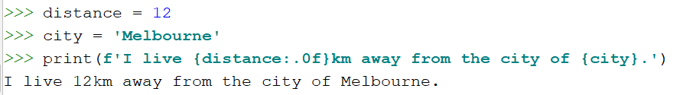
VIT1102 - Introduction to Object Oriented Programming
Output formatting with f-string contd..
Printing 2 variables, string and integer with f-string
Printing a floating point variables with f-string
PI = 3.14159265359 # Use f string - interpolation to evaluate PI print(f'The value of PI is {PI}') # Add precision to output of PI to 2 decimal points print(f'The value of PI is {PI:.2f}') # Output: # The value of PI is 3.14159265359 # The value of PI is 3.14

Slide 38

VIT1102 - Introduction to Object Oriented Programming
Class exercise 3
Complete the following print commands.
Following are two string variables with values assigned.
Use the variables and write print statements to produce output as follows:
a.
b.
c.

Slide 39



VIT1102 - Introduction to Object Oriented Programming
Output formatting - String
Formatting a String output by justifying and setting the field width
Right justify – use ‘>’ symbol
Left Justify – use ‘<‘ symbol
Center Justify – use ‘^’ symbol

Slide 40
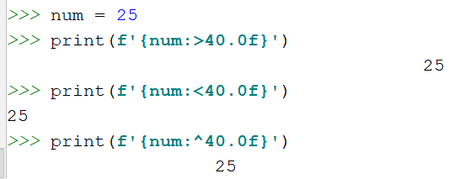
VIT1102 - Introduction to Object Oriented Programming
Output formatting - integer
Formatting an Integer output by justifying and setting the field width
Right, Left or Center Justify

Slide 41
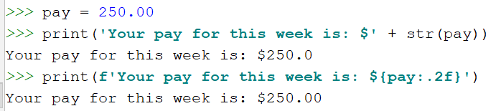

VIT1102 - Introduction to Object Oriented Programming
Output formatting - float
Formatting an floating point number by justifying, setting the field width and precision

Slide 42
VIT1102 - Introduction to Object Oriented Programming
Output formatting more examples
PI = 3.14283567 print('{0:.0f} {0:.1f} {0:.2f} {0:.3f}'.format(PI))
#Output: 3 3.1 3.14 3.143
str0 = 'left' str1 = 'center' str2 = 'right' print('{0:<20} {1:^20} {2:>20}'.format(str0,str1,str2))
#Output:
left center right
Slide by Stefan Batsas 19 July 2018

Slide 43
VIT1102 - Introduction to Object Oriented Programming
Output formatting more examples
How to print a current date in dd/mm/yyyy format:
How to print a specific date in dd/mm/yyyy format:
# need to use the datetime object import datetime # get today's date date = datetime.date.today() # print date in dd/mm/yyyy print('{:%d/%m/%Y}'.format(date))
d = 1 m = 2 y = 2018 date = datetime.date(y, m, d) print('{:%d/%m/%Y}'.format(date))
Slide by Stefan Batsas 19 July 2018

Slide 44



VIT1102 - Introduction to Object Oriented Programming
Escape sequences
expresses special characters, such as the tab, and the newline as literals
Escape sequence | Result | Example command | Output
\n | New line – moves to a new line
\t | Horizontal tab – add a tab space between two literals

Slide 45
VIT1102 - Introduction to Object Oriented Programming
Lecture Reference
Sweigart, A. (2015). Invent Your Own Computer Games with Python 3rd Edition.
Find formatting help in :
https://mkaz.blog/code/python-string-format-cookbook/

